Slide 1
Design Discussion for
FBD Decimation
Jerry Chang

Slide 2
Features
YUV420 to YUV420
Support scaling-down ratios
  1/2, 1/4, and 1/8.
Down-sampled image can be wrote-back to DRAM which follows the reading format of JPEG RENDER.

Slide 3
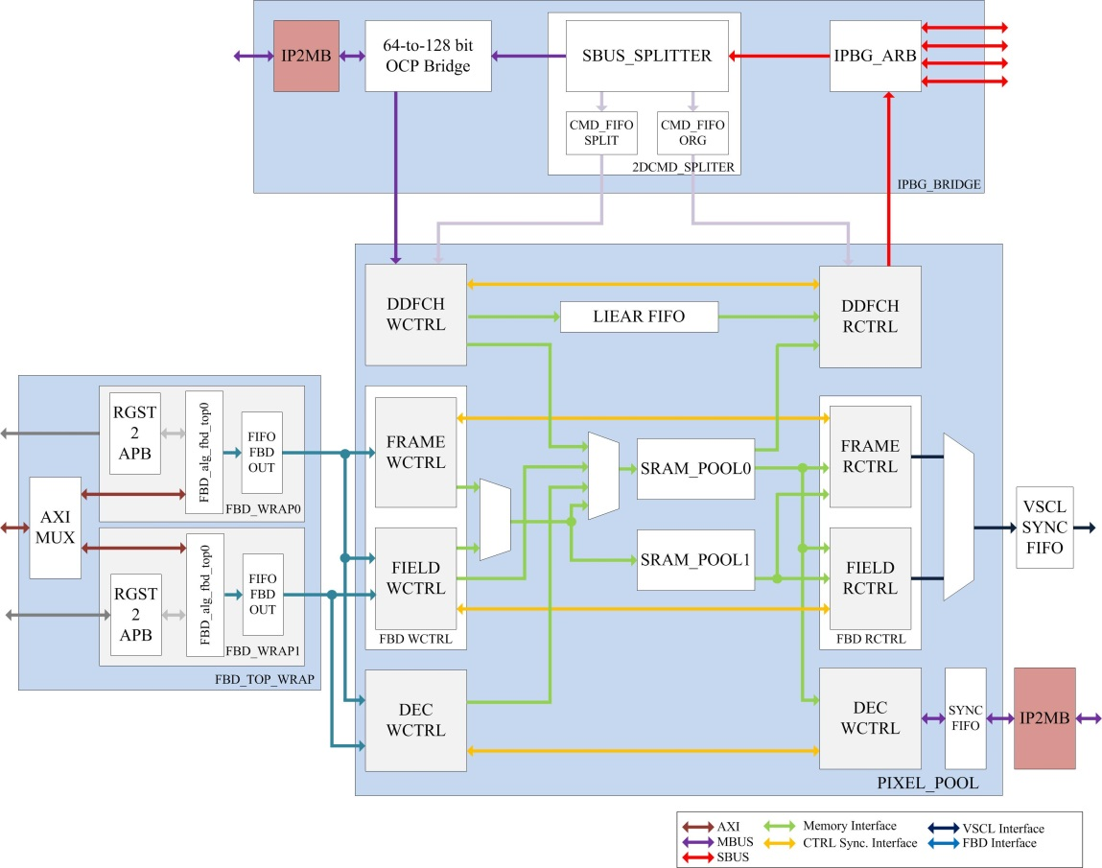
System Overview

Slide 4
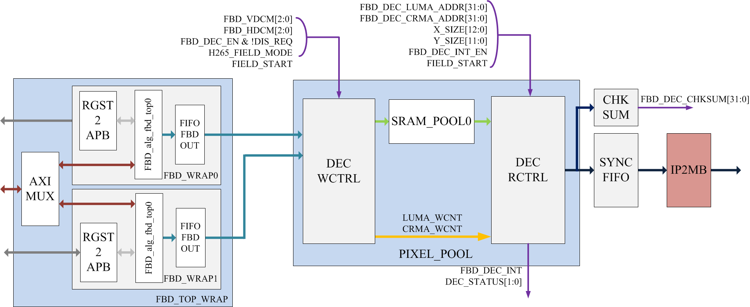
Design Diagram
YUV420 to YUV420

Slide 5
Timing Status & Decimation
See .xls file

Slide 6
Control Flow
Step1: Setup FBD DCM registers
Step2: Setup the FBDs registers
Step3: Start FBD fetching
Step4: Wait until FBD DCM interrupt triggered.
Step5: Return to Step 1 for a new frame.

Slide 7
Local Sim Patterns
Patterns
  DDFCH_4096x2160P_COMP_DEC1
  DDFCH_4096x2160P_COMP_DEC2
  DDFCH_4096x2160P_COMP_DEC4
  DDFCH_4096x2160P_COMP_DEC8
  DDFCH_4096x2160P_COMP_FieldMode_DEC1
  DDFCH_4096x2160P_COMP_FieldMode_DEC2
  DDFCH_4096x2160P_COMP_FieldMode_DEC4
  DDFCH_4096x2160P_COMP_FieldMode_DEC8
  DDFCH_1080P_COMP_DEC8
  DDFCH_1080P_COMP_FieldMode_DEC8
Add a model (YUV Viewer) to capture the raw data and display it.

Slide 8
Schedule
RTL Design (3 days)
Verification (10 days)
Document Writing (3 days)
Target date: 10/25-10/29

